Slide 1
What is shell? A shell is a program that takes commands typed by the user and calls the operating system to run those commands.
Shell accepts your instruction or commands in English and translate it into computers native binary language.

Slide 2
Kind of Shells
Bourne Shell
C Shell
Korn Shell
Bash Shell
Tcsh Shell

Slide 3
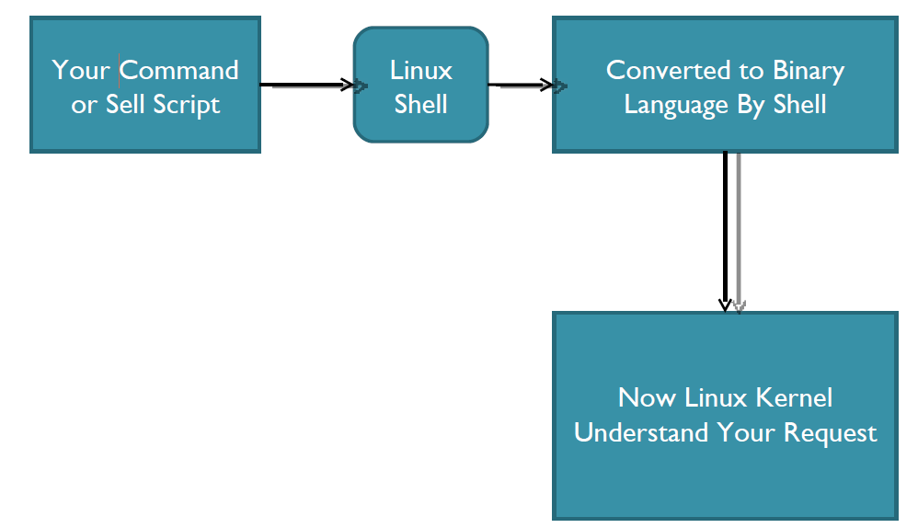
This is what Shell Does for US

Slide 4
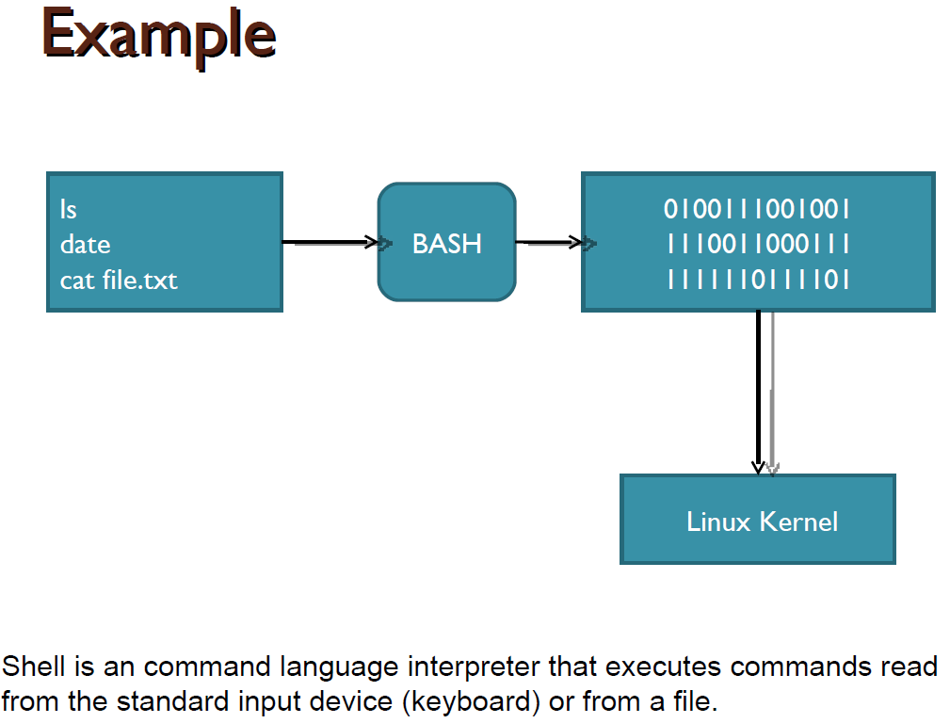

Slide 5
Changing Your Default Shell
 Tip: To find all available shells in your system type following command:
$ cat /etc/shells
 The basic Syntax :
chsh username new_default_shell
 The administrator can change your
default shell.

Slide 6
Shell Scripting
Shell script is a series of command(s) stored
in a plain text file.
A shell script is similar to a batch file in MSDOS,
but is much more powerful.

Slide 7
Practical examples where shell scripting actively used:
1. Monitoring your Linux system.
2. Data backup and creating snapshots.
3. Find out what processes are eating up your system resources.
4. Find out available and free memory.
5. Find out all logged in users and what they are doing.
6. Find out if all necessary network services are running or not.

Slide 8
Create a script
As discussed earlier shell scripts stored in plain text file, generally one command per line.
◦ vi myscript.sh
Make sure you use .bash or .sh file extension for each script. This ensures easy identification of shell script.

Slide 9
Setup executable permission
Once script is created, you need to setup executable permission on a script. Why?
Without executable permission, running a script is almost impossible.
Besides executable permission, script must have a read permission.
Syntax to setup executable permission:
◦ $ chmod +x your-script-name.
◦ $ chmod 755 your-script-name.

Slide 10
Run a script (execute a script)
Now your script is ready with proper executable permission on it. Next, test script by running it.
◦ bash your-script-name
◦ sh your-script-name
◦ ./your-script-name
 Examples
◦ $ bash bar
◦ $ sh bar
◦ $ ./bar

Slide 11
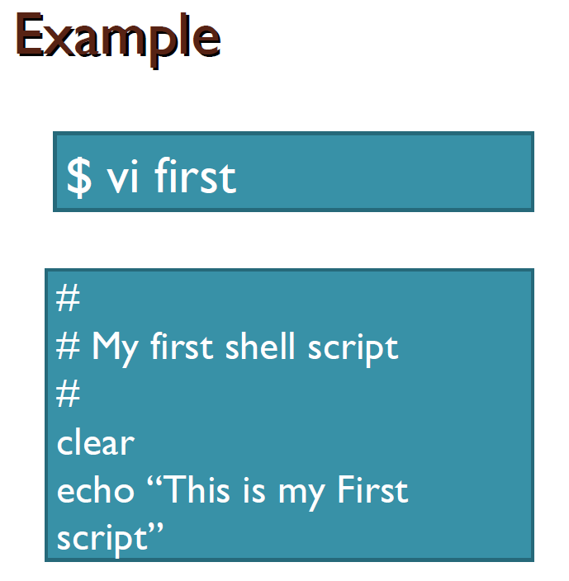

Slide 12
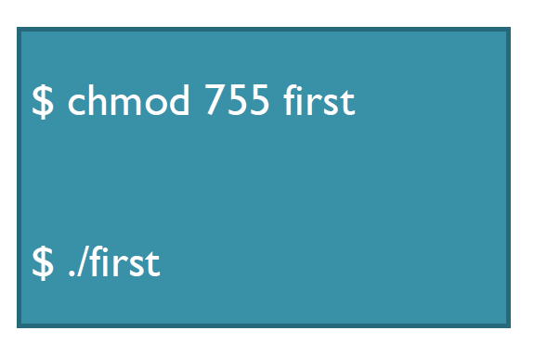

Slide 13
Using Exit code($?)
Every Linux or Unix command executed by the shell script or user has an exit status.
Exit status is an integer number. 0 exit status means the command was successful without any errors.
A non-zero (1-255 values) exit status means command was a failure.
Example
date test 1 –gt 0 ; echo $? echo $?

Slide 14
Variables in Shell
In Linux (Shell), there are two types of variable:
◦ System variables - Created and maintained by Linux itself. This type of variable defined in CAPITAL LETTERS.
◦ User defined variables (UDV) – Created and maintained by user. This type of variable defined in lower letters.

Slide 15
System Variables
Variable | Description
PATH | This variable contains a colon (:)-separated list of directories in which your system looks for executable files. The search path.
USER | The username
HOME | Default path to the user's home directory
EDITOR | Path to the program which edits the content of files
UID | User's unique ID
TERM | Default terminal emulator
SHELL | Shell being used by the user

Slide 16
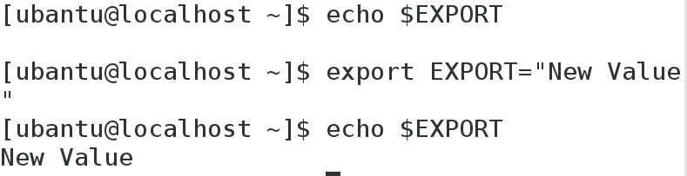
Export command-One can change the shell variable into environment or system variable using export command.

Slide 17
HISTSIZE vs HISTFILESIZE
HISTSIZE is the number of lines or commands that are stored in memory in a history list while
your bash session is ongoing.
HISTFILESIZE is the number of lines or commands that (a) are allowed in the history file at startup
time of a session, and
(b) are stored in the history file at the end of your bash session for use in future sessions.

Slide 18
echo $HISTSIZE
O/P- 1000
HISTSIZE=10
Echo $HISTSIZE
o/p-10
Similarly HISTFILESIZE

Slide 19
Alias command
Used to customize the shell variables.
Aliases are shorthand for longer expressions.
alias myls= “ls -l”

Slide 20
User defined variables (UDV)
To define UDV use following syntax:
◦ variable name=value
◦ $ no=10
Rules for Naming variable name
Variables must begin with a letter.
Spaces are not allowed.
Underscore can be allowed.
No special character in variable name.
Variables are case-sensitive.

Slide 21
Print or access value of UDV
To print or access UDV use following
syntax :
◦ $variablename.
 Examples:
◦ $vech=Bus
◦ $ n=10
◦ $ echo $vech
◦ $ echo $n

Slide 22
Don’t try
◦ $ echo vech
◦ it will print vech instead its value 'Bus‘.
◦ $ echo n
◦ it will print n instead its value '10‘.
“You must use $ followed by variable name.”

Slide 23
Class work
1. Define variable x with value 10 and print it on screen.
2. Define variable xn with value SUST and print it on screen.
3. print sum of two numbers, let's say 6 and 3 .

Slide 24
Example of UDV
A=10
Ba=20
BA=30
HOSTNAME=$ (hostname)
DATE=`date`
123var=333
wrong@var=False
Hyphen-var=Falsehyphen value

Slide 25
Positional Variables(Parameters)
These are also called command line arguments.
$0 name of the script
$1 first argument
$2 second argument
$3 third argument
$# total number of arguments
$* value of all arguments

Slide 26
Positional Variables(Parameters)
$vim filename.sh
touch $1 $2
echo “files created”
echo “Total number of arguments passed $#”
echo “vale of the arguments passed is $*”
Save this and make it executable and run
$./filename.sh abc def (abc and def are file names which are passed as arguments)

Slide 27
Shell Arithmetic
Syntax:
◦ expr op1 math-operator op2
 Examples:
◦ $ expr 1 + 3
◦ $ expr 2 – 1
◦ $ expr 10 / 2
◦ $ expr 20 % 3
◦ $ expr 10 \* 3
◦ $ echo `expr 6 + 3`

Slide 28
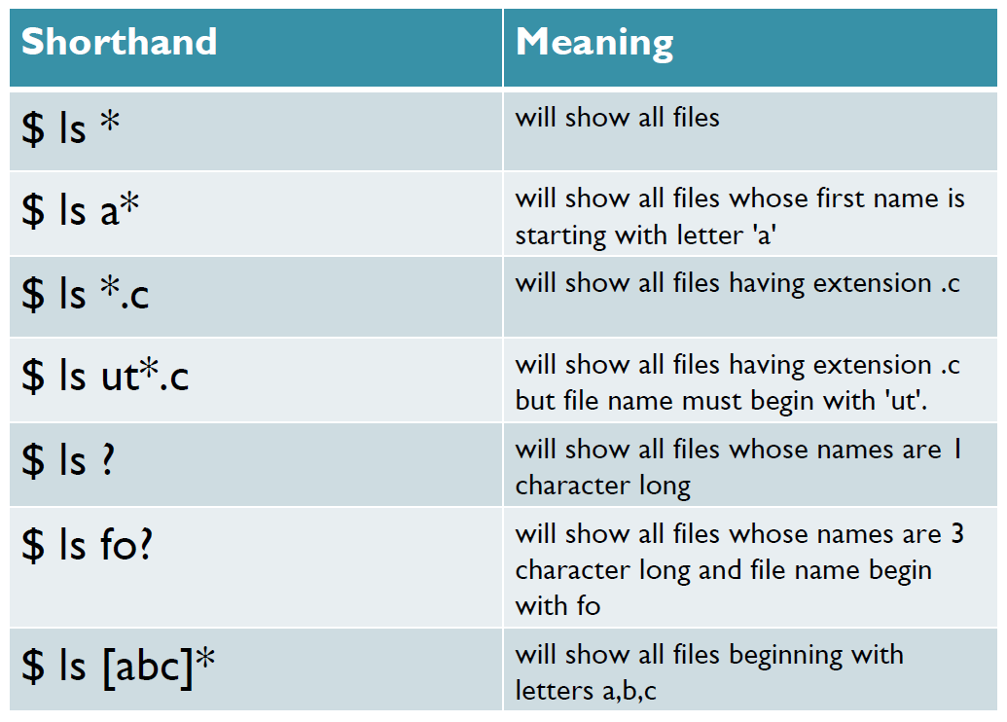
Shorthand

Slide 29
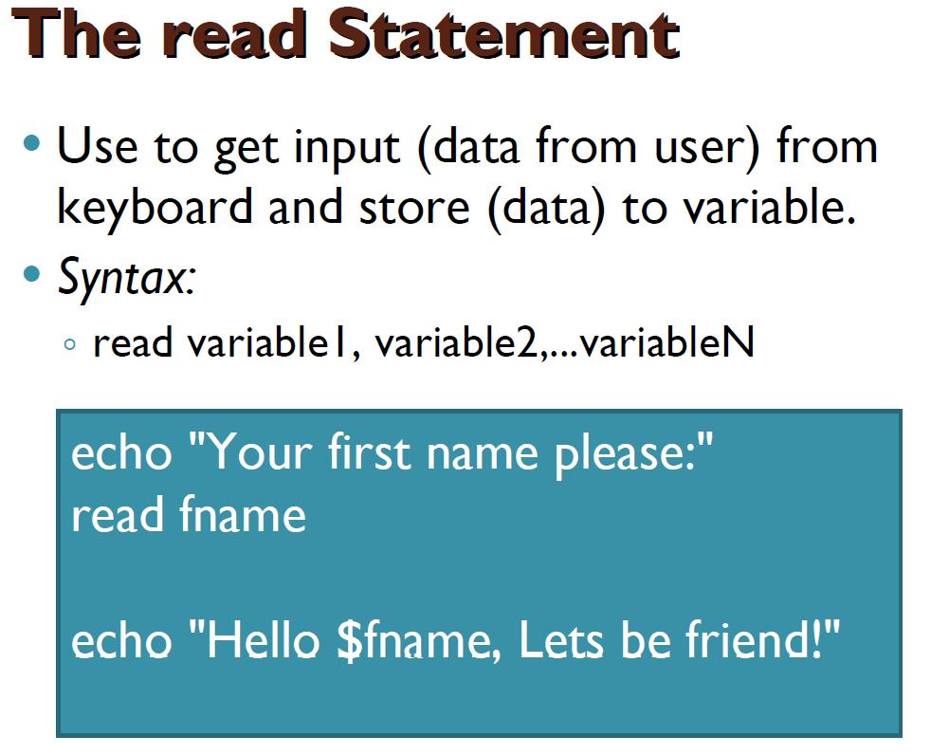

Slide 30
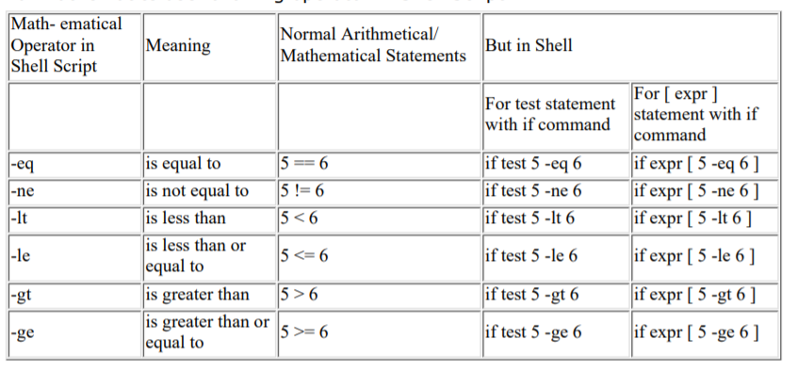
Shell Relational

Slide 31
Test command or [expr]
test command or [ expr ] is used to see if an expression is true, and if it is true it return zero(0), otherwise returns nonzero(>0) for false.
Syntax: test expression OR [ expression ]

Slide 32
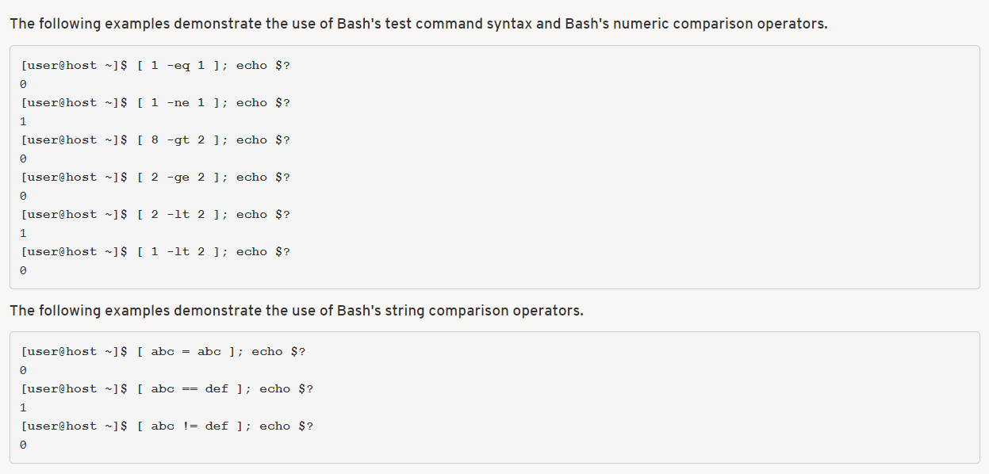

Slide 33
Shell Logical Expressions
! Not not must be enclosed within [ ]
&& and
|| or and, or
must be enclosed within
[[ ]]

Slide 34
Example: Using the ! Operator
#!/bin/bash
read -p "Enter years of work: "Years
if [ ! "$Years" -lt 20 ]; then
echo "You can retire now.“
else
echo "You need 20+ years to retire“
fi

Slide 35
Example: Using the (–a) or && Operator
The logical AND (-a) operator will give true if both the operands are true. Otherwise, false.
In the following example we will check if the number is even and greater than 10.
#!/bin/sh
# take a number from the user
echo "Enter a number: "
read a
# check
if [ `expr $a % 2` == 0 -a $a -gt 10 ]
then
echo "$a is even and greater than 10."
else
echo "$a failed the test."
fi

Slide 36
Example: Using the (–o) or || Operator
The logical OR -o operator will give true if any one of the operand is true. If both operands are false then it will return false.
In the following example we will check if entered number is either odd or less than 10.
#!/bin/sh
# take a number from the user
echo "Enter a number: "
read a
# check
if [ `expr $a % 2` != 0 -o $a -lt 10 ]
then
echo "$a is either odd or less than 10."
else
echo "$a failed the test."
fi

Slide 37
File Test Operators
d : True if the file exists and is a directory.
e : True if the file exists.
f : True if the file exists and is a regular file.
r : True if the file exists and is readable.
s : True if the file exists and has a size greater than zero.
w : True if the file exists and is writable.
x : True if the file exists and is executable.
L/h : True if the file exists and is a symbolic link.

Slide 38
if condition
Syntax:
if condition
then
command1 if condition is true or if exit status
of condition is 0 (zero)
fi

Slide 39
Example
$ vim myscript.sh
read choice
if [ $choice -gt 0 ]; then
echo "$choice number is positive"
else
echo "$ choice number is negative"
fi

Slide 40
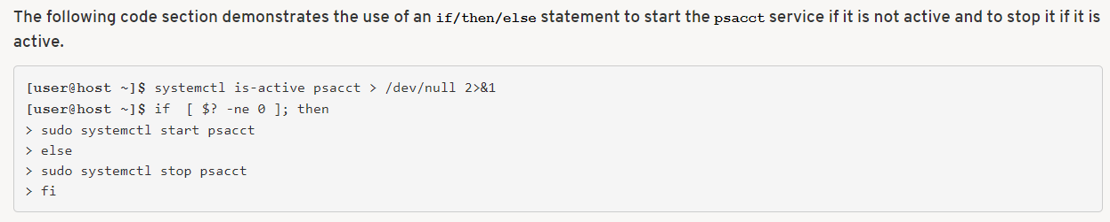
psacct.service-The psacct service is responsible for starting and stopping process accounting at system boot time and at system shutdown.

Slide 41
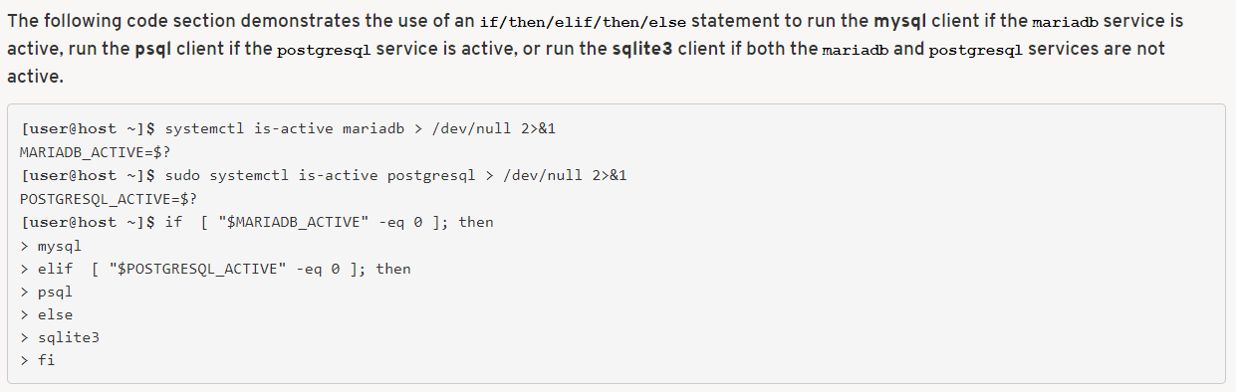
Use of if/then/elif/then/else

Slide 42
# The following THREE if-conditions produce the same result
* DOUBLE SQUARE BRACKETS
read -p "Do you want to continue?" reply
if [[ $reply = "y" ]]; then
echo "You entered " $reply
fi
* SINGLE SQUARE BRACKETS
read -p "Do you want to continue?" reply
if [ $reply = "y" ]; then
echo "You entered " $reply
fi
* "TEST" COMMAND
read -p "Do you want to continue?" reply
if test $reply = "y"; then
echo "You entered " $reply

Slide 43
Nested if-else-fi
$ vi nestedif.sh
echo "1. Unix (Sun Os)"
echo "2. Linux (Red Hat)"
echo -n "Select your os choice [1 or 2]? "
read osch
if [ $osch -eq 1 ] ; then
echo "You Pick up Unix (Sun Os)"
else
if [ $osch -eq 2 ] ; then
echo "You Pick up Linux (Red Hat)"
else
echo "What you don't like Unix/Linux OS."
fi
fi

Slide 44
Loops in Shell Scripts
Bash supports:
1. for loop.
2.while loop.
Note that in each and every loop:
◦ First, the variable used in loop condition must be
initialized, then execution of the loop begins.
◦ A test (condition) is made at the beginning of each iteration.
◦ The body of loop ends with a statement that
modifies the value of the test (condition) variable.

Slide 45
for Loop
Syntax:
for { variable name } in { list }
do
execute one for each item in the list until the list is not finished and repeat all statement between do and done
done

Slide 46
Example
for i in 1 2 3 4 5
do
echo "Welcome $i times"
done

Slide 47
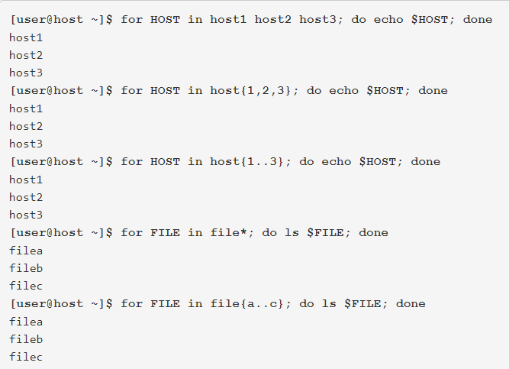

Slide 48
for Loop
Syntax:
for (( expr1; expr2; expr3 ))
do
repeat all statements between
do and done until expr2 is TRUE
Done

Slide 49
Example
for (( i = 0 ; i <= 5; i++ ))
do
echo "Welcome $i times"
done

Slide 50
Nesting of for Loop
$ vi nestedfor.sh
for (( i = 1; i <= 5; i++ ))
do
for (( j = 1 ; j <= 5; j++ ))
do
echo -n "$i "
done

Slide 51
while loop
Syntax:
while [ condition ]
do
command1 command2 command3 .. ....
done

Slide 52
Example
i=1
while [ $i -le 10 ]
do
echo "$n * $i = `expr $i \* $n`"
i=`expr $i + 1`
done

Slide 53
The case Statement
Syntax:
case $variable-name in
pattern1) command…..;;
pattern2) command…..;;
pattern N) command….;;
.
*) command ;;
esac

Slide 54
Example
read var
case $var in
1) echo “One”;;
2) echo “Two”;;
3) echo “Three”;;
4) echo “Four”;;
*) echo "Sorry, it is bigger than Four";;
esac

Slide 55
Array
Shell supports a different type of variable called an array variable. This can hold multiple values at the same time.
Defining Array Values
array—name[index]=value
Examples
Name[0]=“ABC”
Name[1]=“PQR”
Name[2]=“XYZ”
Name[3]=“GOD”
Accessing Array Values
${array—name[index]}
You can access all the items in an array in one of the following ways −
${array-name[*]}
${array-name[@]}

Slide 56
Array Script
echo "enter name"
read -a names
echo "names :${names[0]}, ${names[1]}

Slide 57
Select command
Constructs simple menu from word list
Allows user to enter a number instead of a word
User enters sequence number corresponding to the word
Syntax:
select WORD in LIST
do
RESPECTIVE-COMMANDS
done
Loops until end of input, i.e. ^d (or ^c)

Slide 58
Select example
#! /bin/bash
select var in alpha beta gamma
do
echo $var
done
Prints: 1) alpha
2) beta
3) gamma
#? 2
beta
#? 4
#? 1
alpha

Slide 59
The until Loop
Purpose:
To execute commands in “command-list” as long as “expression” evaluates to false
Syntax:
until [ expression ]
do
command-list
done

Slide 60
Example: Using the until Loop
#!/bin/bash
COUNTER=20
until [ $COUNTER -lt 10 ]
do
echo $COUNTER
let COUNTER-=1
done

Slide 61
break and continue
The break statement
transfer control to the statement AFTER the done statement
terminate execution of the loop
The continue statement
transfer control to the statement TO the done statement
skip the test statements for the current iteration
continues execution of the loop

Slide 62
The break command
while [ condition ]
do
cmd-1
break
cmd-n
done
echo "done"
This iteration is over and there are no more iterations

Slide 63
The continue command
while [ condition ]
do
cmd-1
continue
cmd-n
done
echo "done"
This iteration is over; do the next iteration

Slide 64
Example:
for index in 1 2 3 4 5 6 7 8 9 10
do
if [ $index –le 3 ]; then
echo "continue"
continue
fi
echo $index
if [ $index –ge 8 ]; then
echo "break"
break
fi
done

Slide 65
Grep: matches a pattern throughout a file.
Grep <string> <filename>
Grep <string> <filename> <filename>
Options
-i: ignore case
-v: invert match.To select non-matching lines.
-c: counting no. of matches

Slide 66
Basic Regular expressions
Symbol | Descriptions
. | matches a single character
^ | matches start of string
$ | matches end of string
* | matches up zero or more times the preceding character
\ | Represent special characters
() | Groups regular expressions
? | Matches up exactly one character

Slide 67
[a1v]---any one character out of a or 1 or v
[^a1v]---any character except a, 1 and v
[[:alnum:]]---Alphanumeric [a-z A-Z 0-9]
[[:alpha:]]---Alphabetic [a-z A-Z]
[[:blank:]]---Blank characters (spaces or tabs)
[[:digit:]]---Numbers [0-9]
[[:lower:]]---Lowercase letters [a-z]
[[:upper:]]---Uppercase letters [A-Z]
[[:xdigit:]]---Hex digits [0-9 a-f A-F]

